Slide 1
Unit III String Handling
Chapter 15

Slide 2
Contents
String Constructors
String Functions
Length, Special String operations, Character Extraction
Comparison, Searching
Modifying, Changing Case
Additional Methods
String Buffer
String Builder

Slide 3
Overview
A string is a sequence of characters
String is NOT a character array (as like in C/C++)
Java implements strings as objects of type String.
“String” restriction:
Each time you need an altered version of an existing string, a new String object is created that contains the modifications
But, this has been overcome in StringBuffer and StringBuilder

Slide 4
1. String Constructors
String s = new String(); - Creates an empty string
String s = new String(“value”); - Creates a string with “value”
String s = new String(char ch[]); - with character array
String s = new String(char ch[], int startIndex, int numChars); - subrange of a character array
String s = new String(String s1); - with other string object

Slide 5
1. String Constructors...
Using Ascii:
String(byte asciiChars[ ])
String(byte asciiChars[ ], int startIndex, int numChars)
Using Unicode:
String(int codePoints[ ], int startIndex, int numChars)

Slide 6
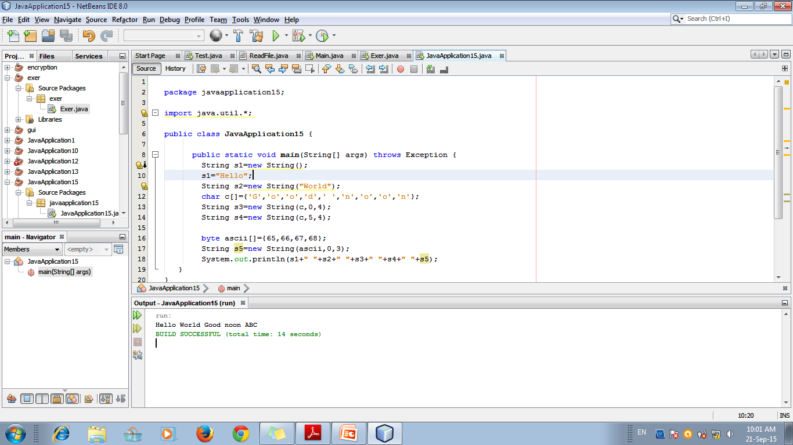

Slide 7
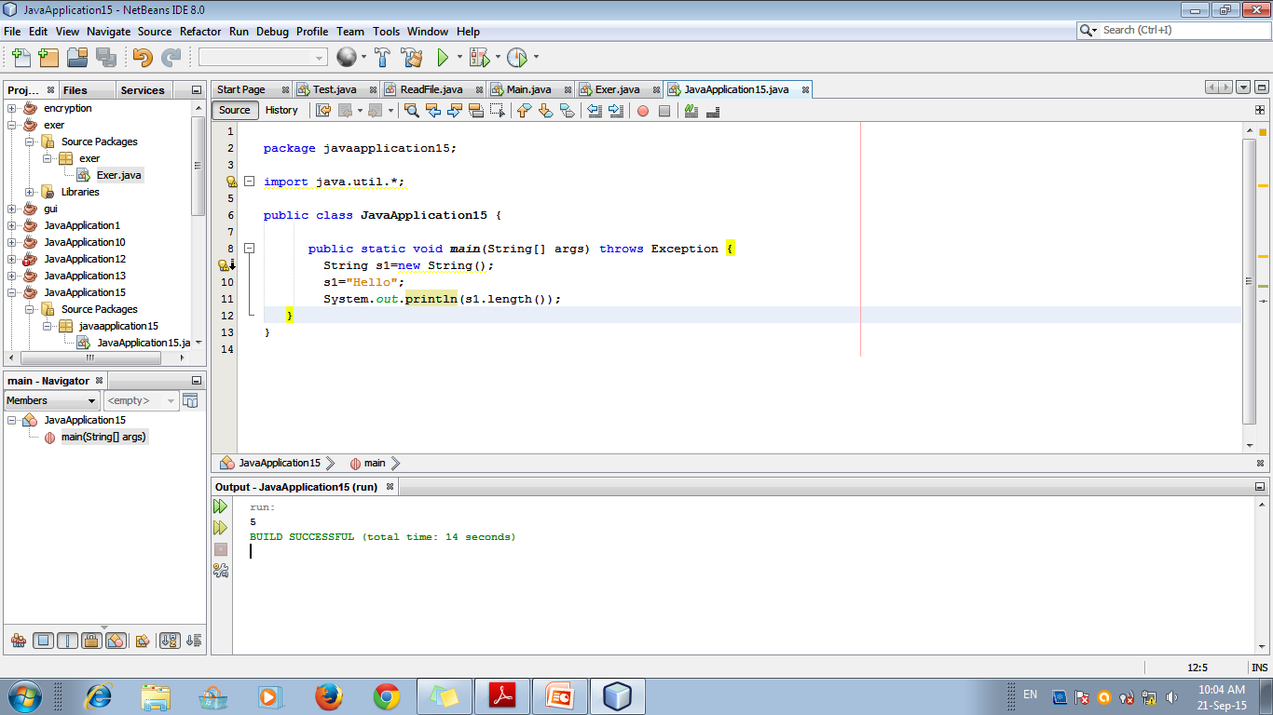
2. String Length
The length of a string is the number of characters that it contains
int l = str.length();

Slide 8
3. Special String Operations
Includes:
automatic creation of new String instances from string literals,
concatenation of multiple String objects by use of the + operator, and
the conversion of other data types to a string representation

Slide 9
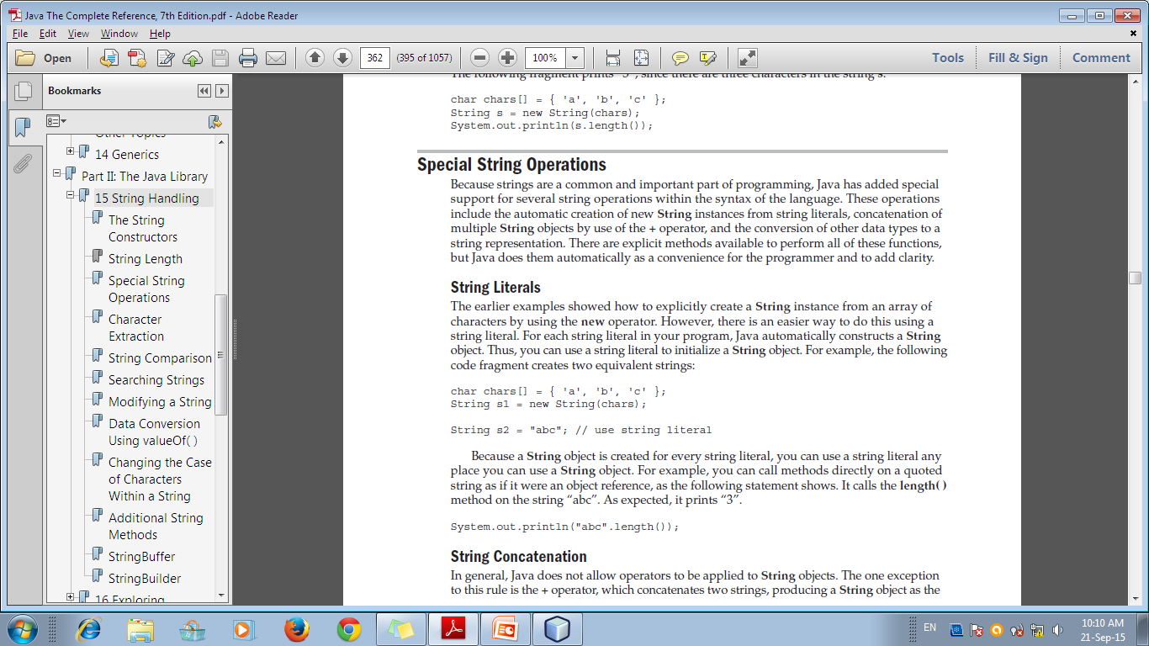
a) String Literals
Use a string literal to initialize a String object

Slide 10
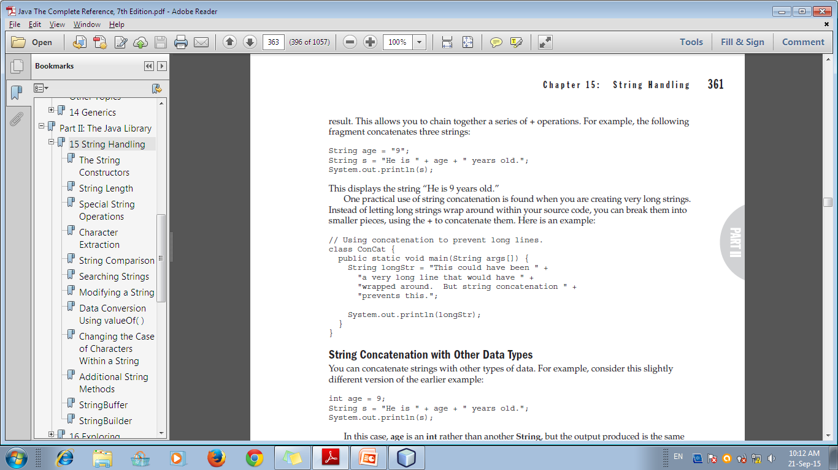
b) String Concatenation
Also used to create long string with “breaks”

Slide 11
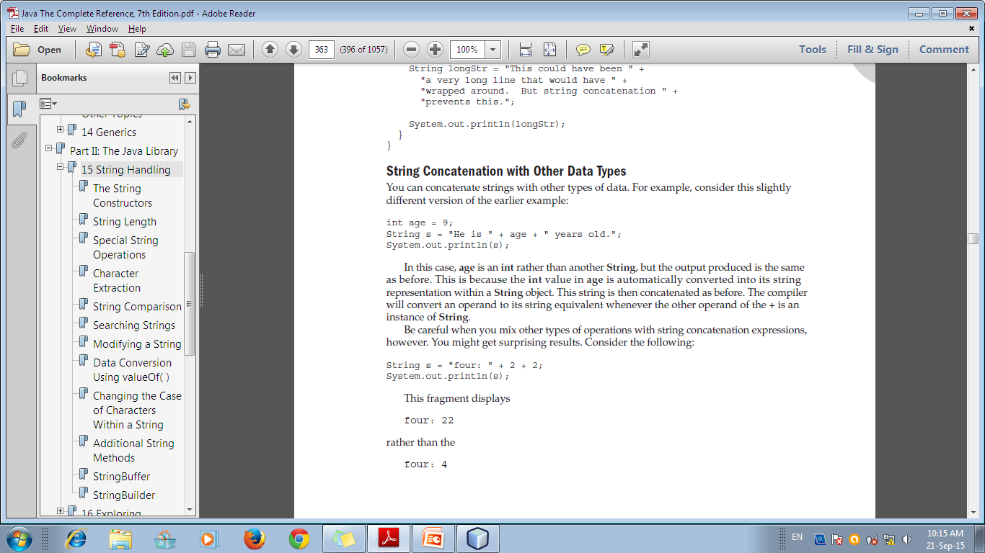
Concatenation with other data types

Slide 12
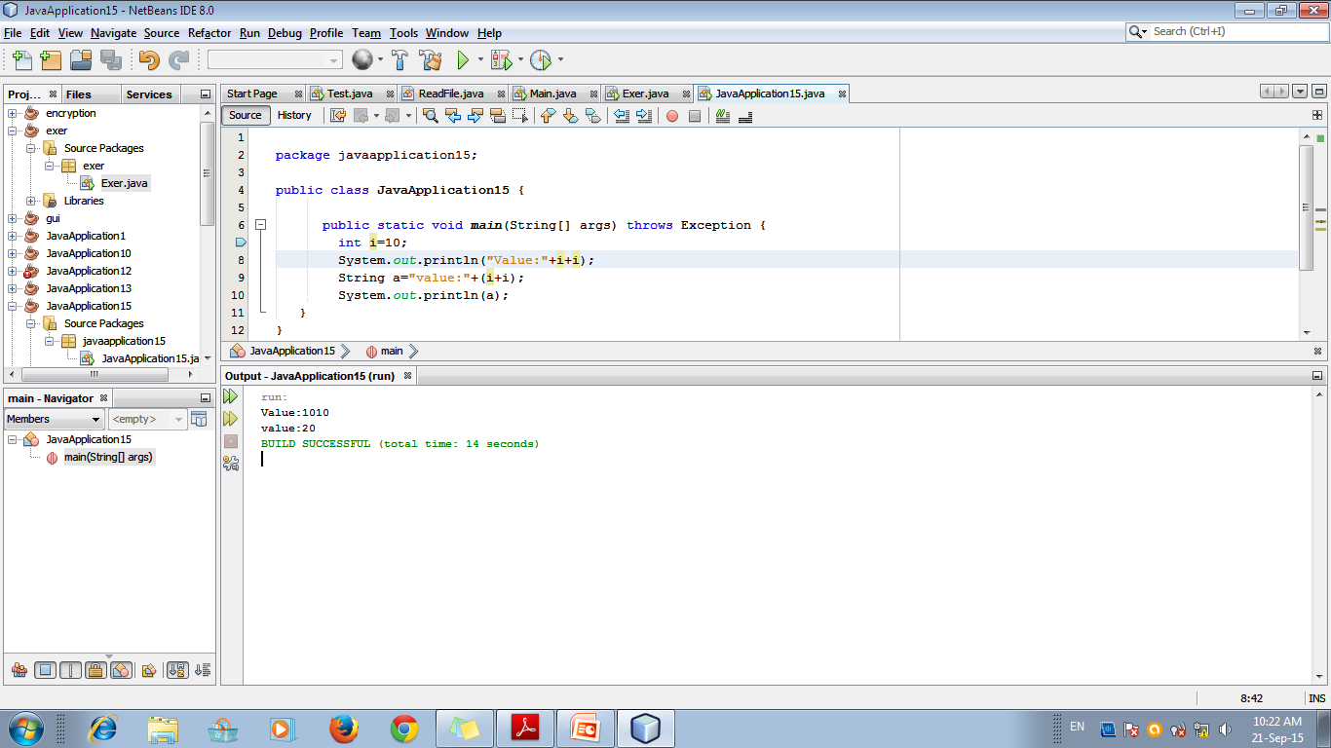

Slide 13
c) String Conversion
Using toString() method
returns a string that contains the human-readable equivalent of the value with which it is called.

Slide 14
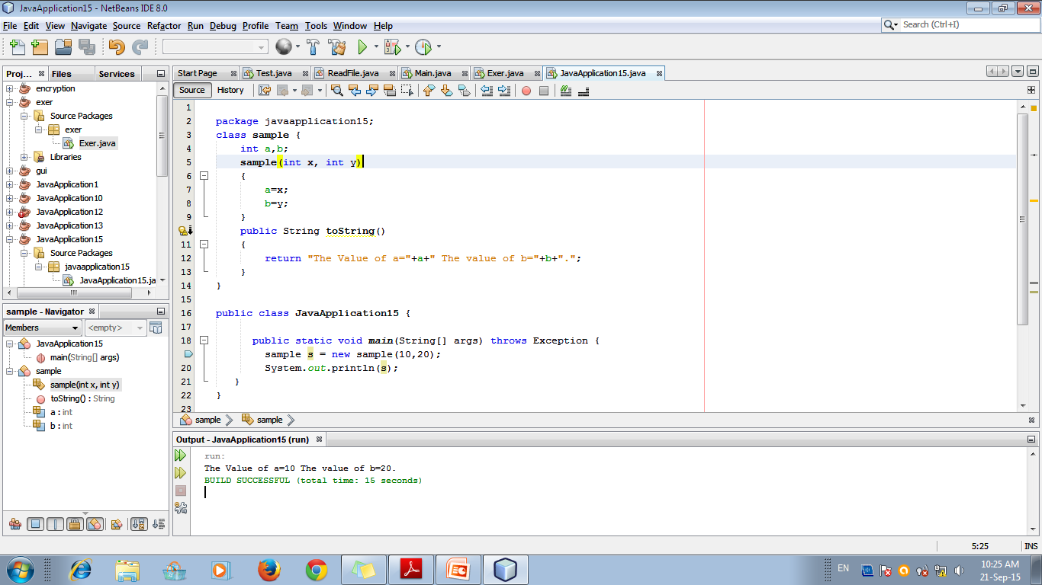

Slide 15
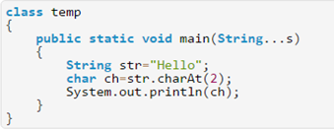

4) Character Extraction
1) charAt()- Used to extract a single character at an index
char charAt(int where) – “where” is the index of the character that you want to obtain

Slide 16
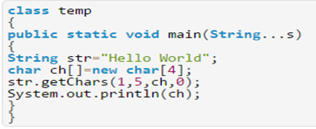

4) Character Extraction...
2)getChars()- Used to extract more than one chracter
void getChars(int sourceStart, int sourceEnd, char target[ ], int targetStart)
sourceStart → index of the beginning of the substring,
sourceEnd → index of the ending of the substring
target[] → char array that receives from start to end-1
Targetstart → starting index of target[] array

Slide 17

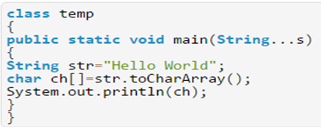

4) Character Extraction
3)byte[] getbytes() – converts all chars to byte array
char[] toCharArray() – converts all chars to char array

Slide 18
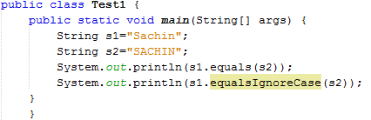

5) String Comparison
boolean equals(Object str)
E.g.., String s1=“abc”; String s2=“xyz”; Boolean b;
b= s1.equals (s2);
boolean equalsIgnoreCase(String str)

Slide 19
5) String Comparison
boolean regionMatches(int startIndex, String str2, int str2StartIndex, int numChars)
Compares specific region inside a string with another specific region in another string.
boolean regionMatches(boolean ignoreCase, int startIndex, String str2, int str2StartIndex, int numChars)
Compares specific region inside a string with another specific region in another string with ignoring case.

Slide 20
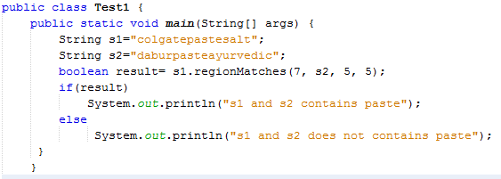

5) String Comparison

Slide 21
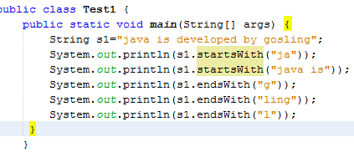
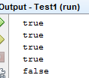
5) String Comparison...
boolean startsWith(String str)
boolean endsWith(String str)
Used to check whether a string is starting or ending with a suffix or prefix.

Slide 22
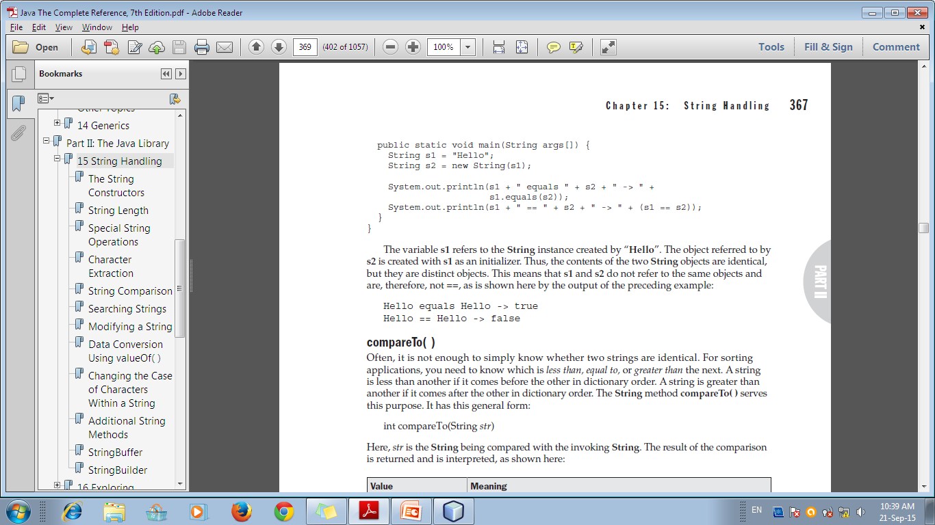
5) String Comparison...
equals() vs “==”
the equals( ) method compares the characters inside a String object
The == operator compares two object references to see whether they refer to the same instance

Slide 23
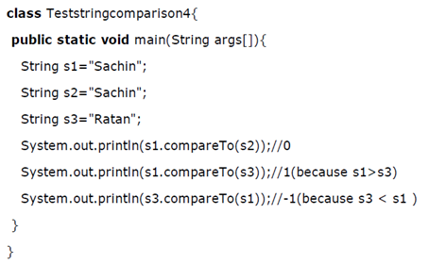
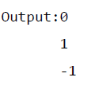
5) String Comparison...
int compareTo()
Identifies: less than, equal to, or greater than (based on ascii value of 1st character)

Slide 24
6) Searching Strings
indexOf( )
Searches for the first occurrence of a character or substring.
lastIndexOf( )
Searches for the last occurrence of a character or substring
Various Possibilities:
int indexOf(int ch); int lastIndexOf(int ch)
int indexOf(String str); int lastIndexOf(String str)
int indexOf(int ch, int startIndex); lastindex…
int indexOf(String str, int startIndex); lastindex...

Slide 25
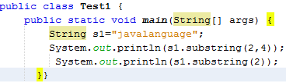

7) Modifying a String- Substring()
Use a separate copy of the String, or copy into a StringBuffer or StringBuilder
Take a separate copy of it by using:
String substring(int startIndex) → returns a substring that begins at startIndex and runs to the end of the invoking string
String substring(int startIndex, int endIndex) → returns a substring from startIndex until the previous char of endIndex

Slide 26
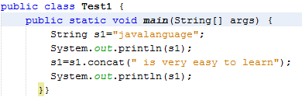

7) Modifying a String- concat()
The following methods are used:
concat( ) – concatenate two strings and returns as string object; s1.concat(s2) → s1s2

Slide 27
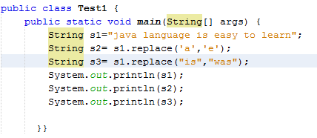

7) Modifying a String- replace()
replace( )
String replace(char original, char replacement) – replaces all occurrences of original char as replacement char
String replace(CharSequence original, CharSequence replacement) – replaces all sequence of occurrences.

Slide 28
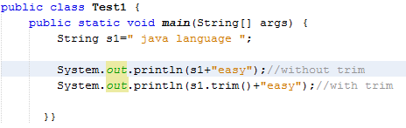

7) Modifying a String-trim()
trim( ) – removes any leading or trailing white spaces.

Slide 29
8) Data Conversion
valueOf( )
Converts data from its internal format into a human-readable form
Called when a string representation of some other type of data is needed. E.g.., While concatenation – toString() is hence called
Methods:
static String valueOf(double num)
static String valueOf(long num)
static String valueOf(Object ob)
static String valueOf(char chars[ ])

Slide 30
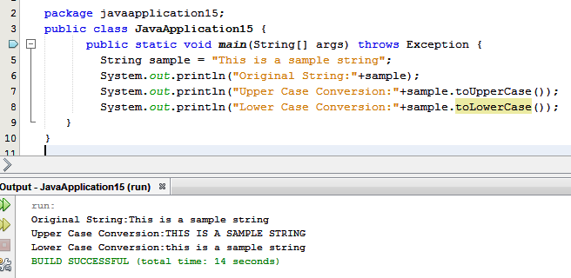
9) Changing Case
String toLowerCase( ) String toUpperCase( )

Slide 31
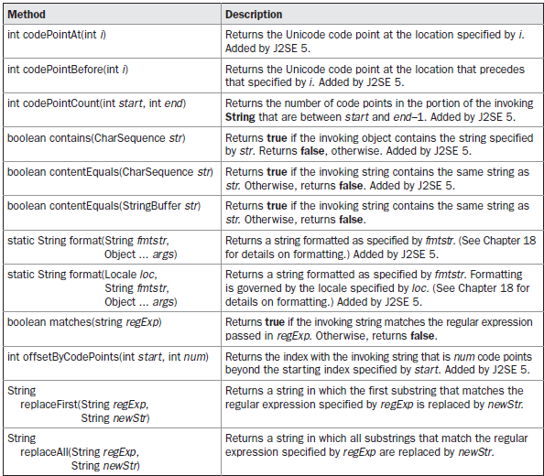
10) Additional String Methods

Slide 32
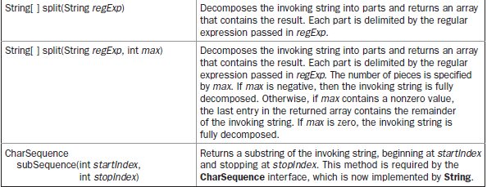
10) Additional String Methods...

Slide 33
11) StringBuffer
String – represents fixed-length, immutable character sequences
StringBuffer – represents growable and writeable character sequences
StringBuffer will automatically grow to make room for such additions

Slide 34
StringBuffer Constructors
StringBuffer( ) – Default size = 16 characters
StringBuffer(int size)
StringBuffer(String str) = size of str + 16 chars
StringBuffer(CharSequence chars) = size of chars

Slide 35
StringBuffer Functions
length( )
Returns the current length of a StringBuffer
capacity( )
Returns the total allocated capacity of StringBuffer
An empty StringBuffer class contains the default 16 character capacity.
If the number of the character increases from its current capacity, it increases the capacity by (oldcapacity*2)+2.

Slide 36
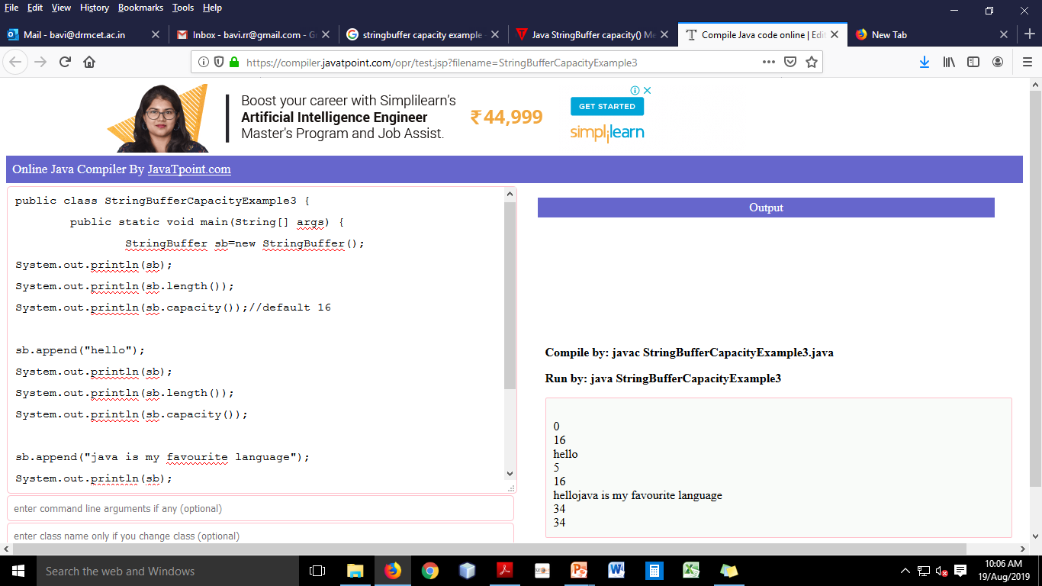
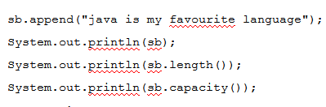

Slide 37
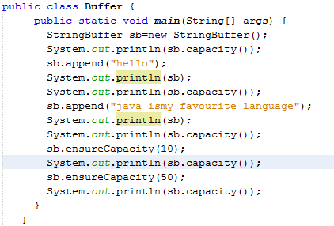
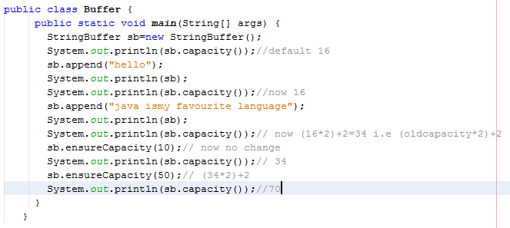
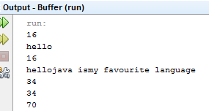
StringBuffer Functions...
ensureCapacity( )
Used to pre-allocate room for a certain number of characters after a StringBuffer has been constructed
void ensureCapacity(int min_capacity)

Slide 38
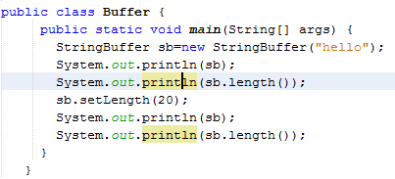
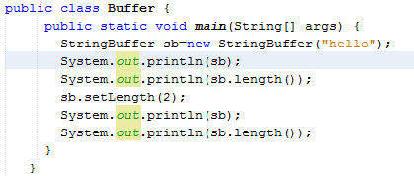
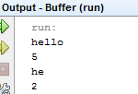
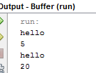
StringBuffer Functions...
setLength( )
To set the length of the buffer within a StringBuffer object
void setLength(int len)
After creating “sb” with data if length is increased, null chars will be added at the end; if length is decreased, content is truncated.

Slide 39
StringBuffer Functions...
charAt()
The value of a single character can be obtained from a StringBuffer
setCharAt( )
To set the value of a character within a StringBuffer
void setCharAt(int where, char ch)
getChars( )
copy a substring of a StringBuffer into an array
void getChars(int sourceStart, int sourceEnd,
char target[],int targetStart)

Slide 40
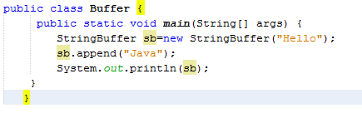

StringBuffer Functions...
append()
concatenates the string representation of any other type of data to a StringBuffer
StringBuffer append(String str)
StringBuffer append(int num)
StringBuffer append(Object obj)

Slide 41
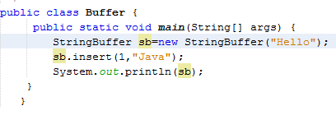

StringBuffer Functions...
insert()
inserts one string into another
StringBuffer insert(int index, String str)
StringBuffer insert(int index, char ch)
StringBuffer insert(int index, Object obj)
index → specifies the index at which point the string will be inserted

Slide 42
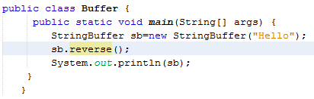

StringBuffer Functions...
reverse()
reverse the characters within a StringBuffer

Slide 43
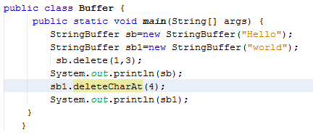

StringBuffer Functions...
delete( ) and deleteCharAt( )
delete characters within a StringBuffer
StringBuffer delete(int startIndex, int endIndex)
deletes chars from (start) to (end-1)
StringBuffer deleteCharAt(int loc)

Slide 44
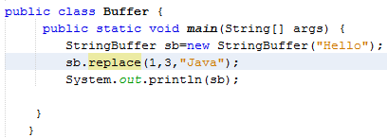

StringBuffer Functions...
replace( )
replace one set of characters with another set
StringBuffer replace(int startIndex, int endIndex, String str)

Slide 45
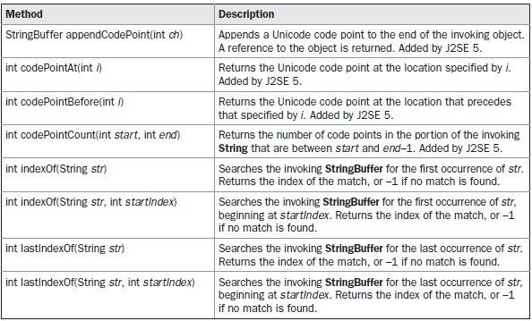
Additional StringBuffer Methods

Slide 46
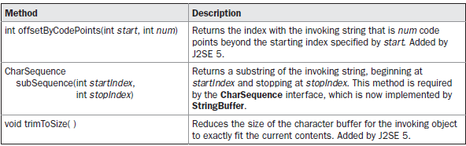
Additional StringBuffer Methods

Slide 47
12) StringBuilder
Added in Java version 5
Similar to StringBuffer
But: NOT SYNCHRONIZED - it is not thread-safe
For multithreading program – use StringBuffer!!! (rather than StringBuilder)
Adv: faster performance

Slide 48
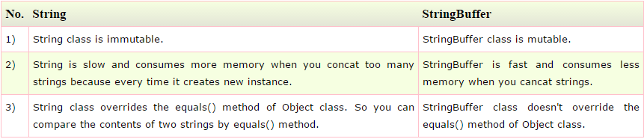
Diff b/w String and StringBuffer

